Slide 1
Green Help
- A Multi-Dimensional Project to tackle Environmental Problems

Slide 2
Contributors;
DEVESH JAIN 20BCE10613
ANIKET DHOKANE 20BCE10736
HARSHIT GUPTA 20BCE10617
ANUP PAL 20BCE10641
MIRYALA KAUTILYA 20BCE10503
Guided by;
Dr M ASHWIN SIR

Slide 3
IDEOLOGY
A project that can solve environmental problems at domestic, local, regional level.
A project that can collect data from users to understand the problem
A project that can showcase solutions to multiple environmental issues.
A project with the best possible ways to interact with audience

Slide 4





User Interaction, Data Collection and Usage
Audience
Mediums of User Data Collection
Website Form
Chatbot
Medium of Solution Sending
Email
SMS
Medium of Data Storage
Excel
APIs
Problems
Solutions
Website pitch

Slide 5



Web Application Comprises
HTML/CSS/JS
Frontend
API
Weather
Bootstrap
Main
Website
Chatbot
Form-spree
GitHub/Netlify
Backend
Hosting

Slide 6
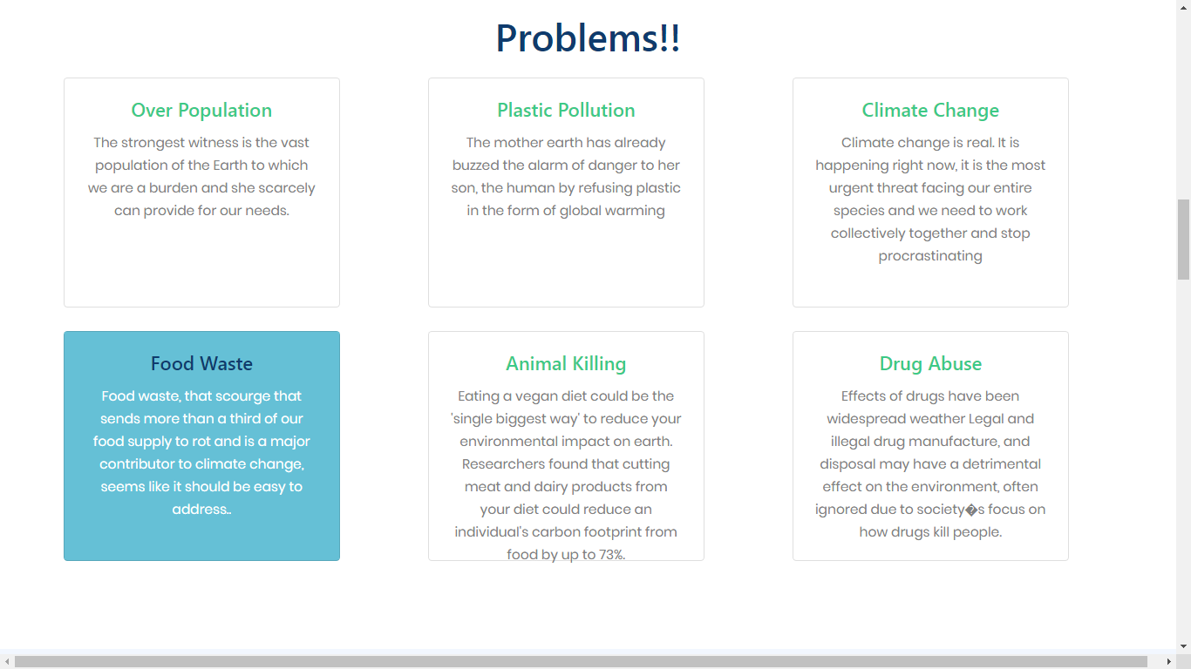
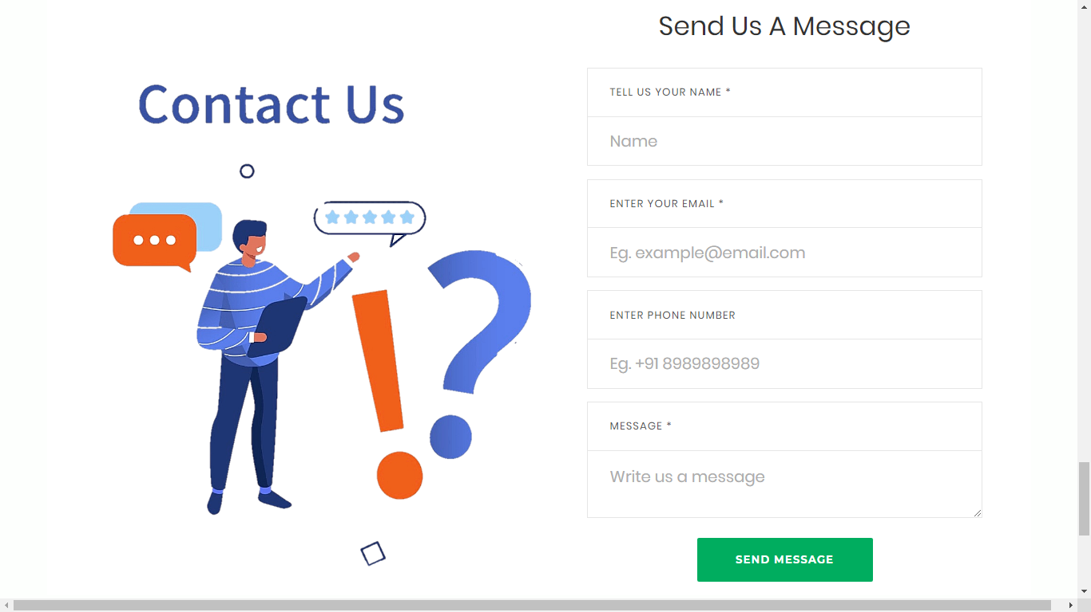
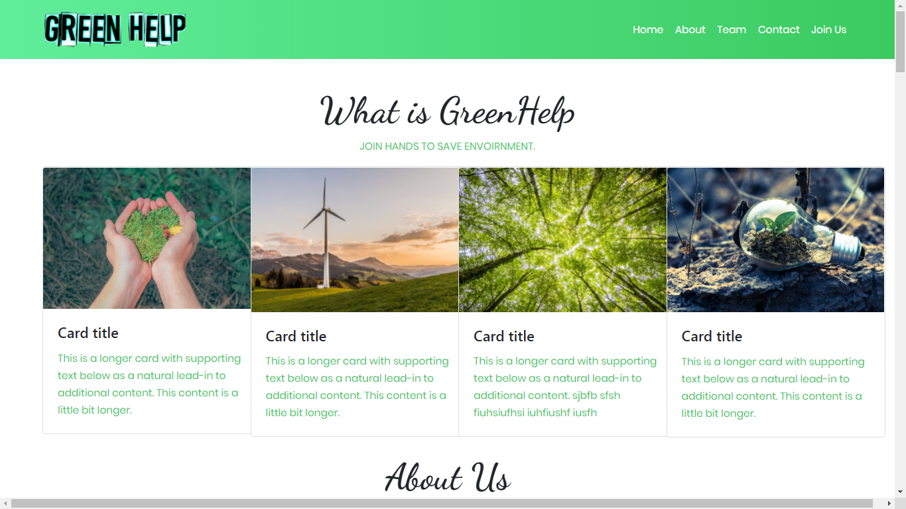
GLIMPS OF THE PROJECT

Slide 7
Review II
Completed Tasks
Frontend of the website is almost completed.
Chatbot has been embedded.
Weather Forecast API is made.

Slide 8
1) Frontend is made using HTML, CSS, JS.
2) Chatbot is made using Third-party application, wherein user responses are received via mail, and are stored in csv file and chatbot application.
3) Openweather API has been used to manually check the temp, humidity, weather type, wind speed, etc. of the city.

Slide 9
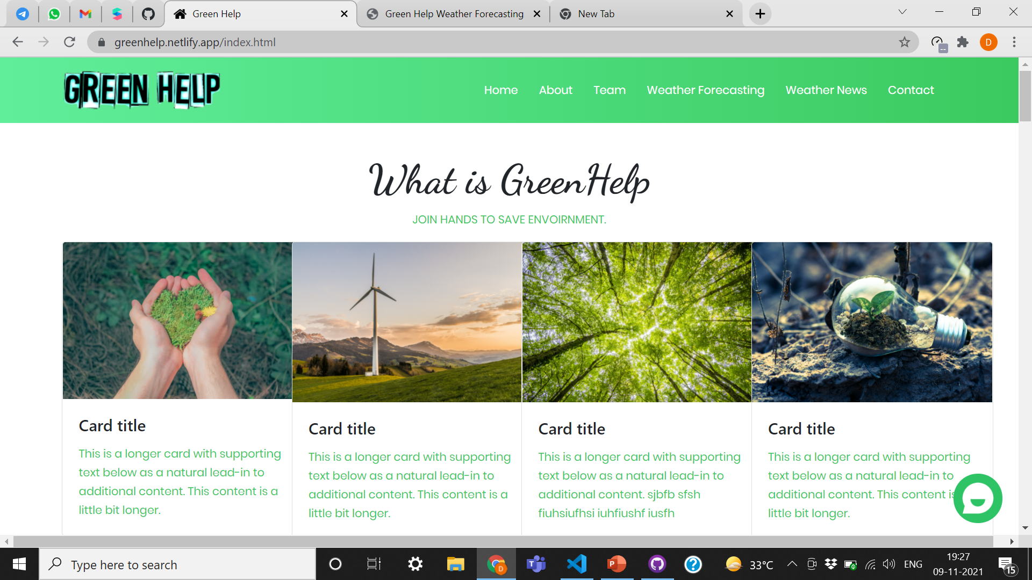
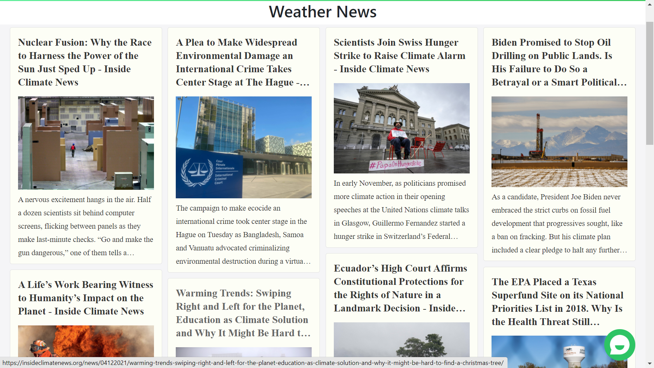
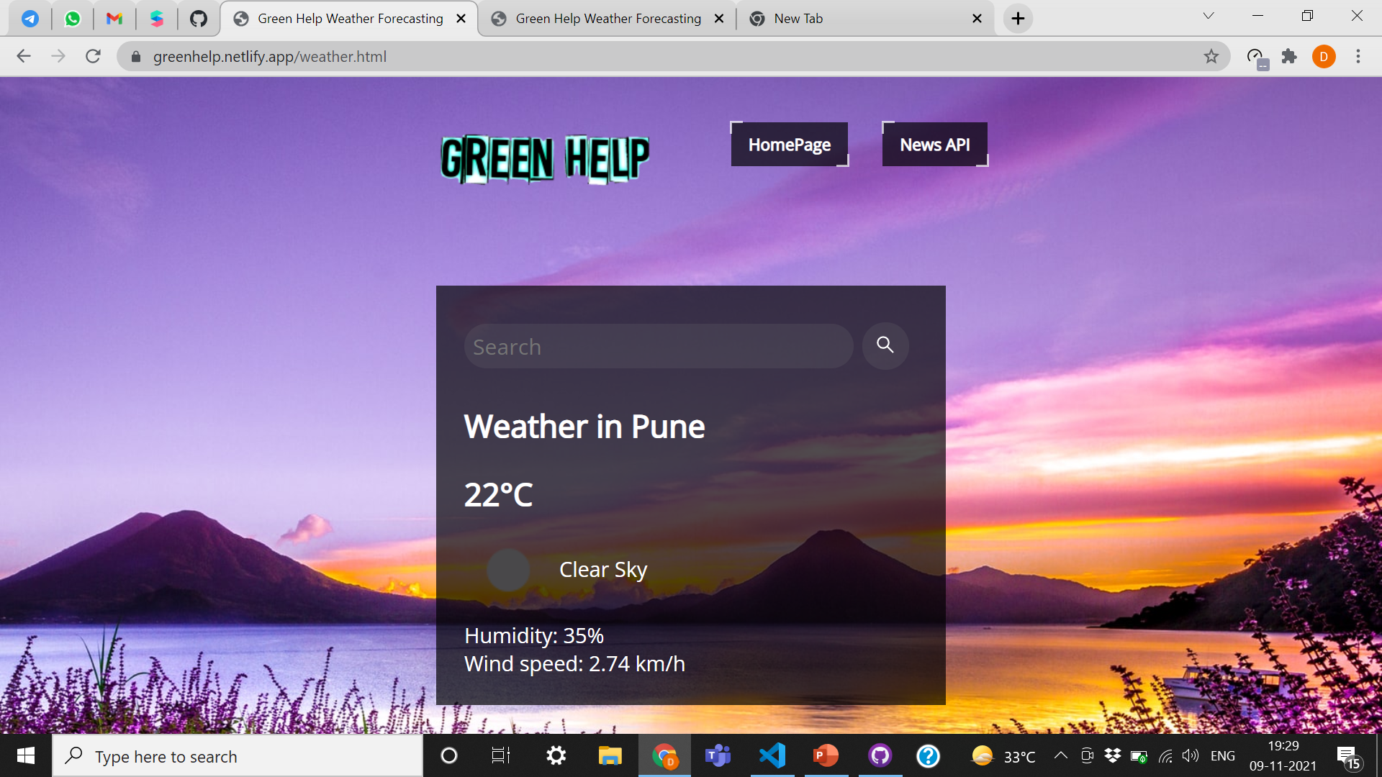
WEB APPLICATION STRUCTURE
MAIN HOMEPAGE
WEATHER FORECASTING
WEATHER NEWS

Slide 10

Ways of Collecting Data from User
Chatbot
User
E-Mail / Application
Form

Slide 11
Ahead in Green Help Project
Form work in the main page
Embedding of Weather News in the project, which in also includes air quality etc.
Designing work
Content, images, and links need to be updated

Slide 12
FINAL REVIEW
Completed Tasks
Frontend of the website is completed.
All forms linked with the data base.
News application has been embedded.

Slide 13
1) Frontend is made using HTML, CSS, JS.
2) HTML form is made using Third-party application, wherein user responses are received via mail, and are stored in csv file and formspree application.
3) insideclimatenews API has been used to automatically fetch the climate related news world wide.

Slide 14
Lists of APIs used in the Project
Chatbot – collect chat (https://dashboard.collect.chat/workspace/60e5fc7d0ac71735ab58e48b)
Html Form - formspree (https://formspree.io/forms/xleazagg/settings)
Weather Forecast - openweathermap (https://openweathermap.org/api)
Climate News - insideclimatenews (https://insideclimatenews.org/)
RSS.app (https://rss.app/feed/B7l0314qnxtbTkhT/embed)

Slide 15
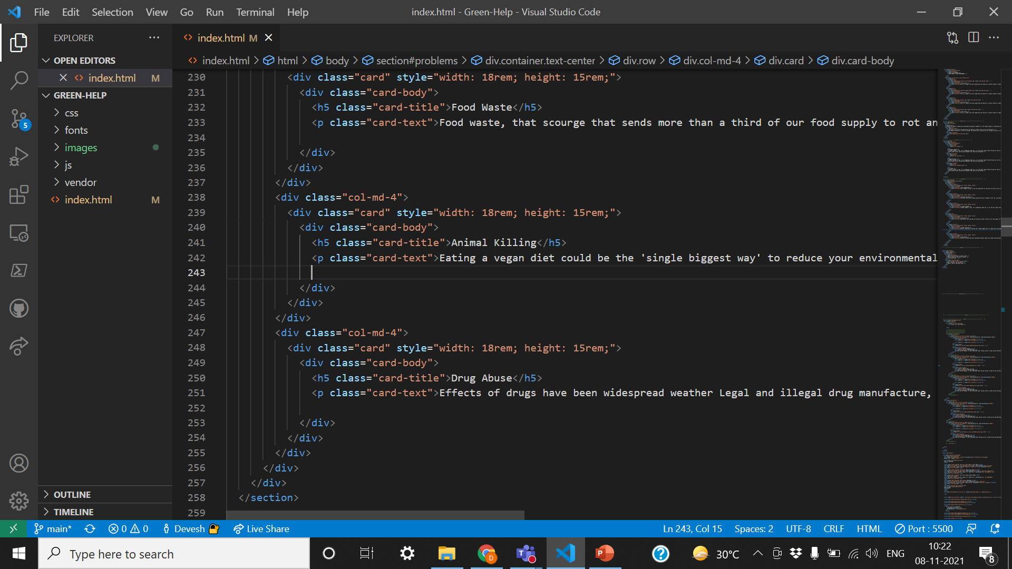
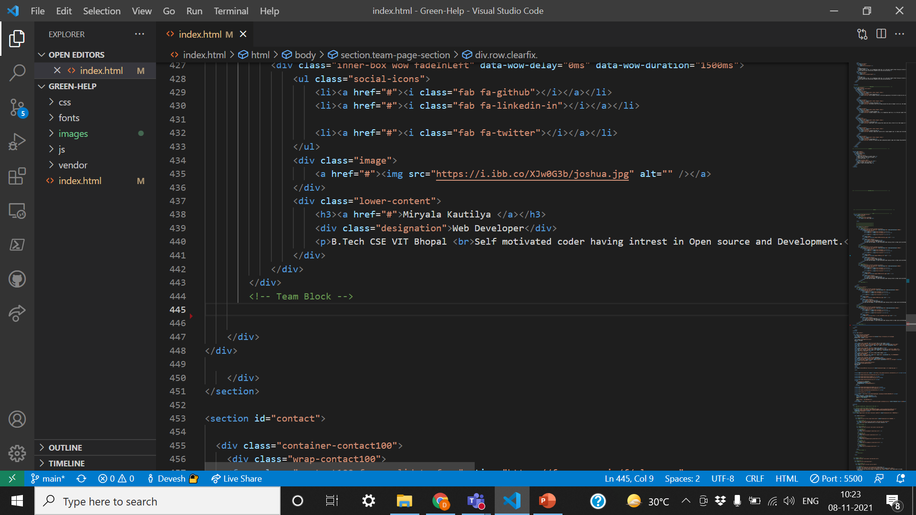
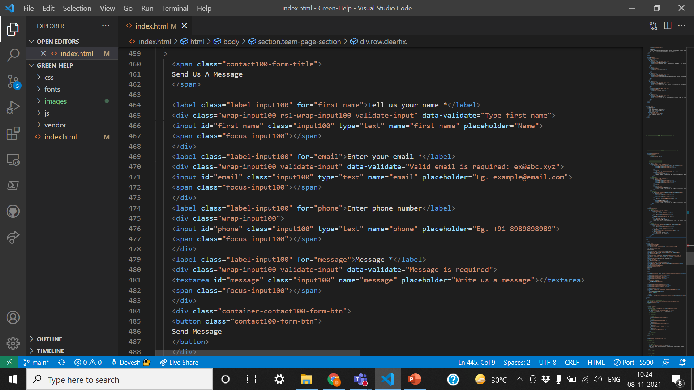
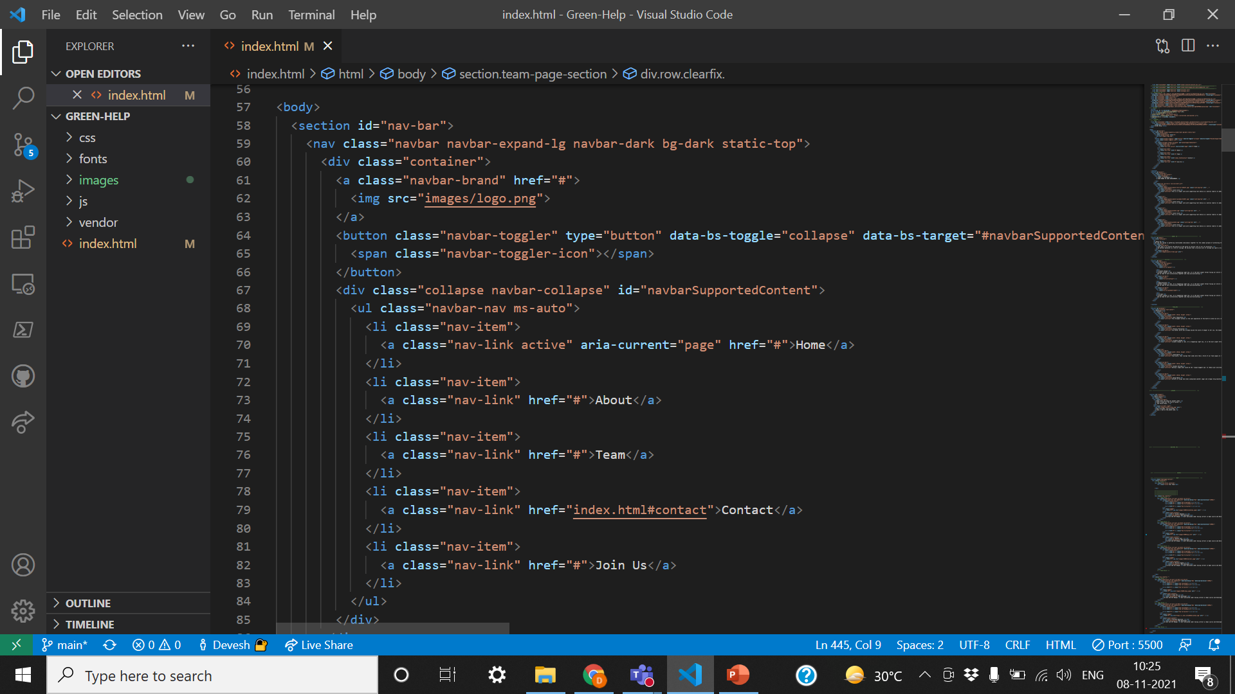
Screenshots of Codes

Slide 16
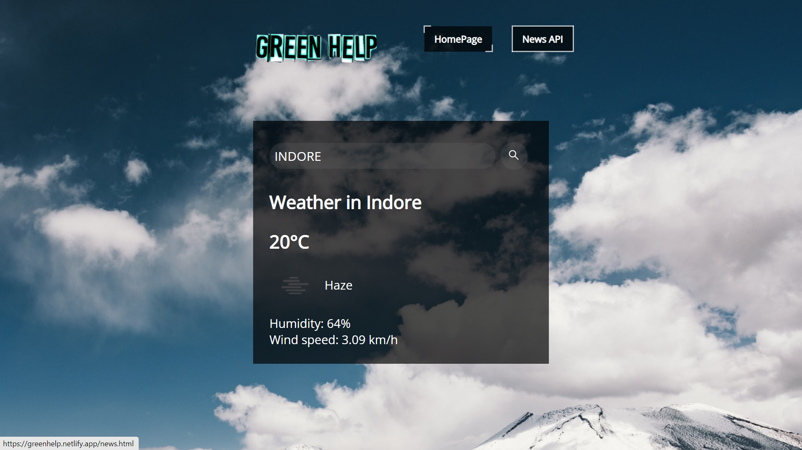
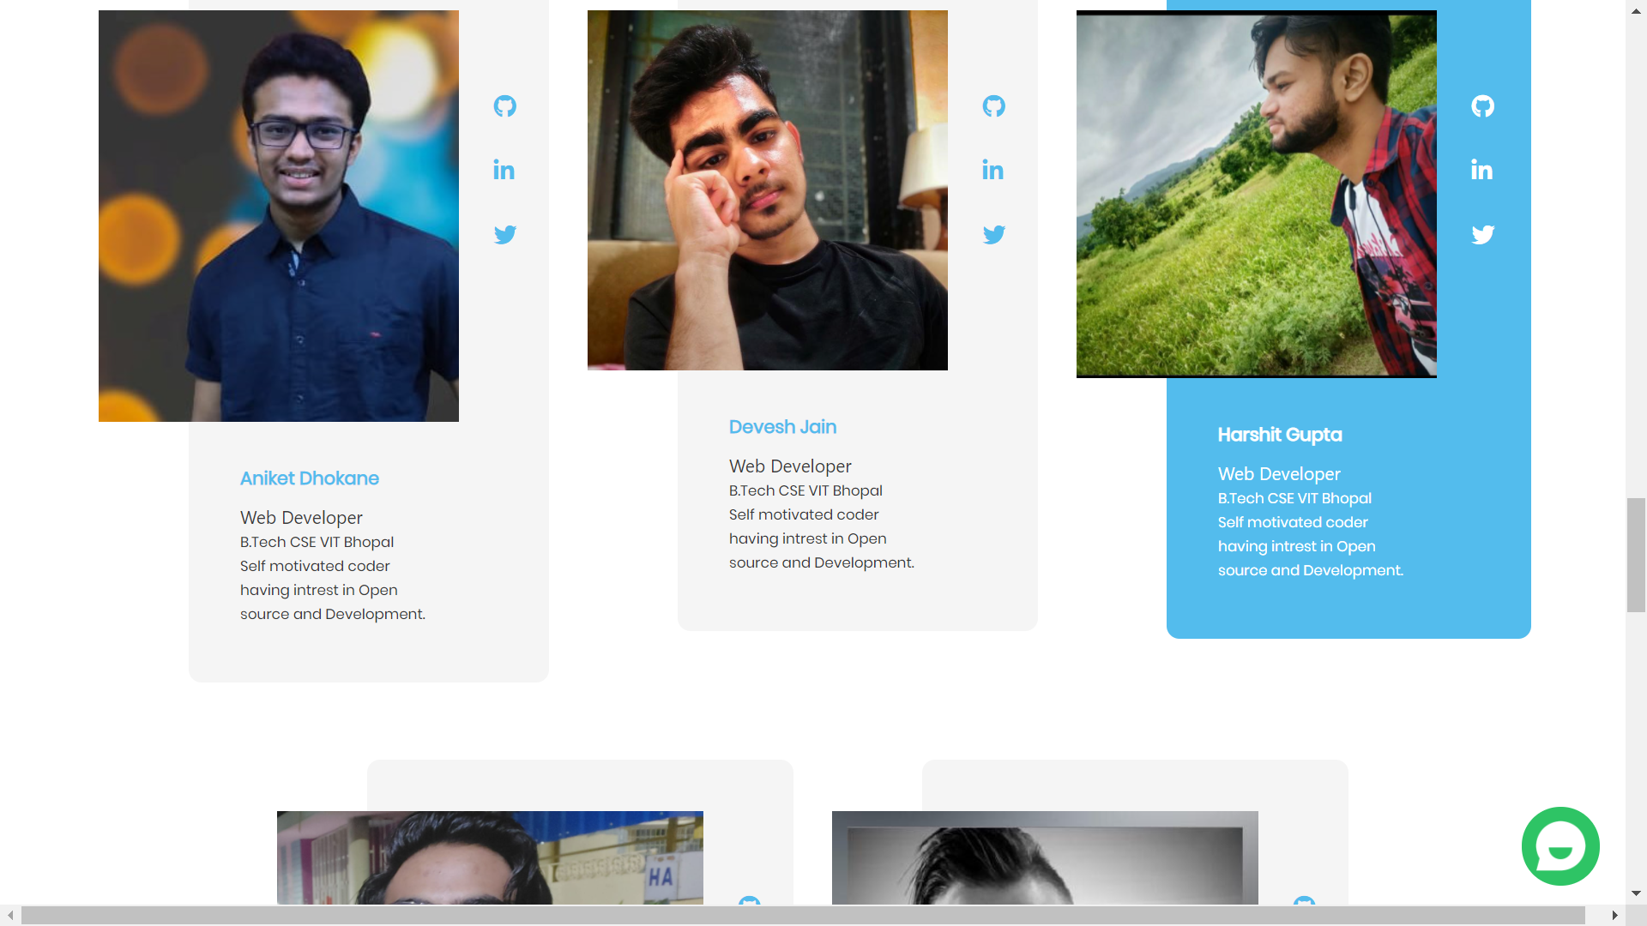
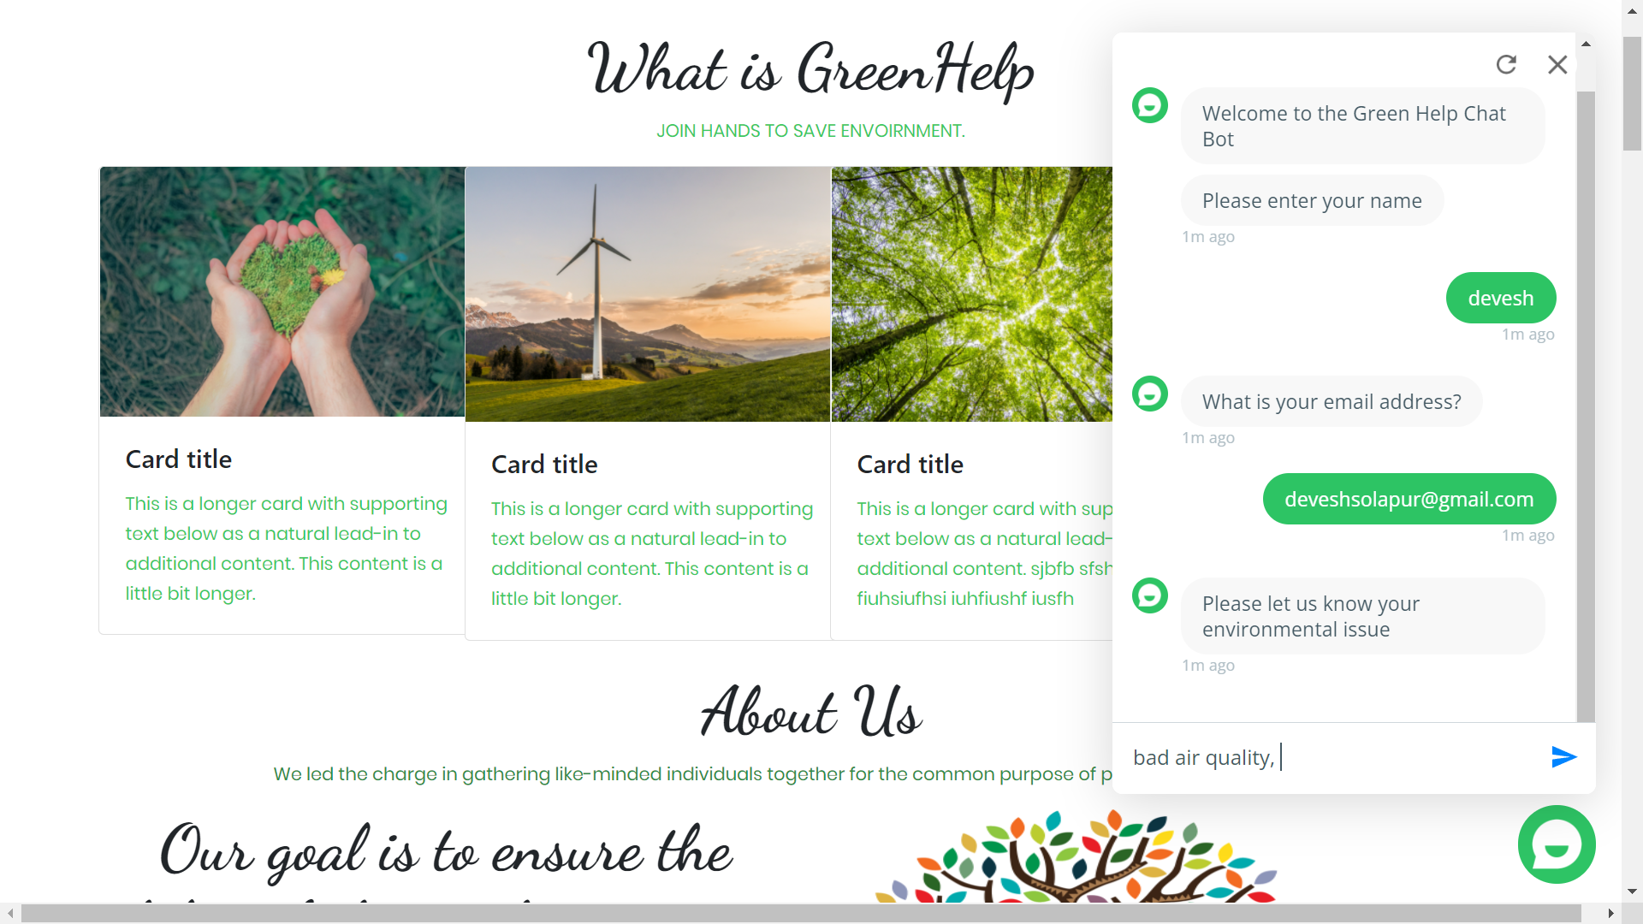
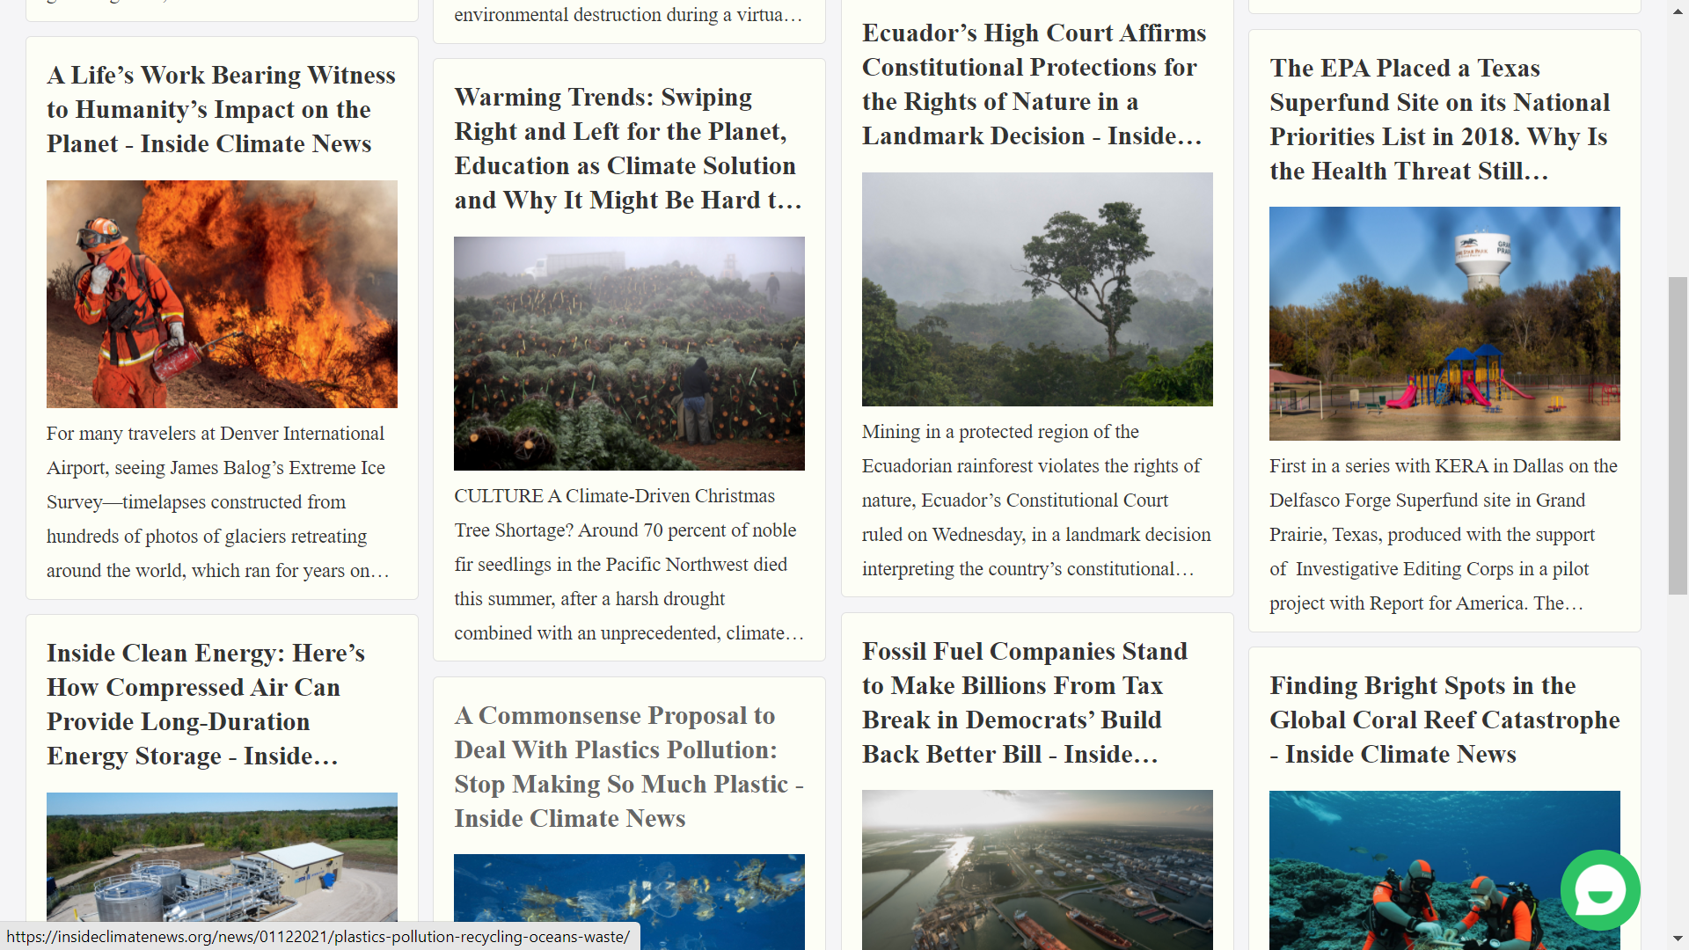
Screenshots of the project

Slide 17
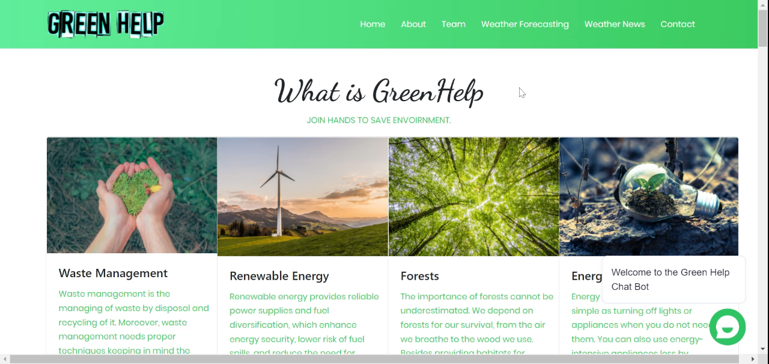
Demo Video
video drive link

Slide 18
Links of the Project
GitHub Repository Link - https://github.com/Green-Help/Green-Help
Website Link - https://greenhelp.netlify.app/ (under construction)
Google Drive Link - https://drive.google.com/drive/folders/1rAqIU7ljJqpFRVODvEIa1ARBcSxdVhbS?usp=sharing

Slide 19
Thank You

